Slide 1

FLIGHT INFO ALERTS
Guidance notes

Slide 2



Contents
Onboarding Guide
Guidance on creating Alerts
Guidance on connecting to the Eventhub
FAQs

Slide 3

Onboarding guide

Slide 4

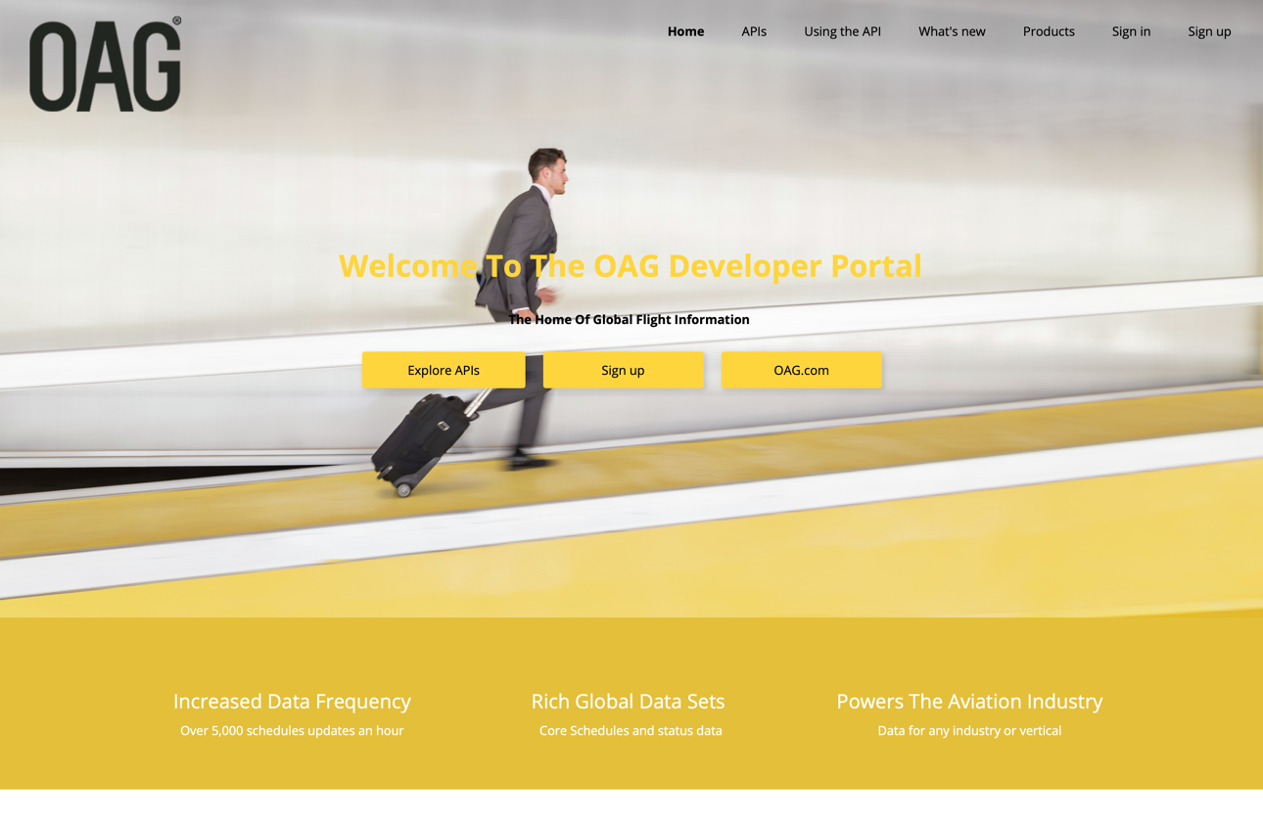
Subscribe to Flight Info Alert Product
Pre-requisite You will need an OAG Developer Portal account by going to Home – OAG Developer Portal. Also, you can read about the Flight Info Alerts product.
Step one On the home page you could either; select “products” from the top right menu or scroll down to “Our APIs” and select “Try it out”.

Slide 5
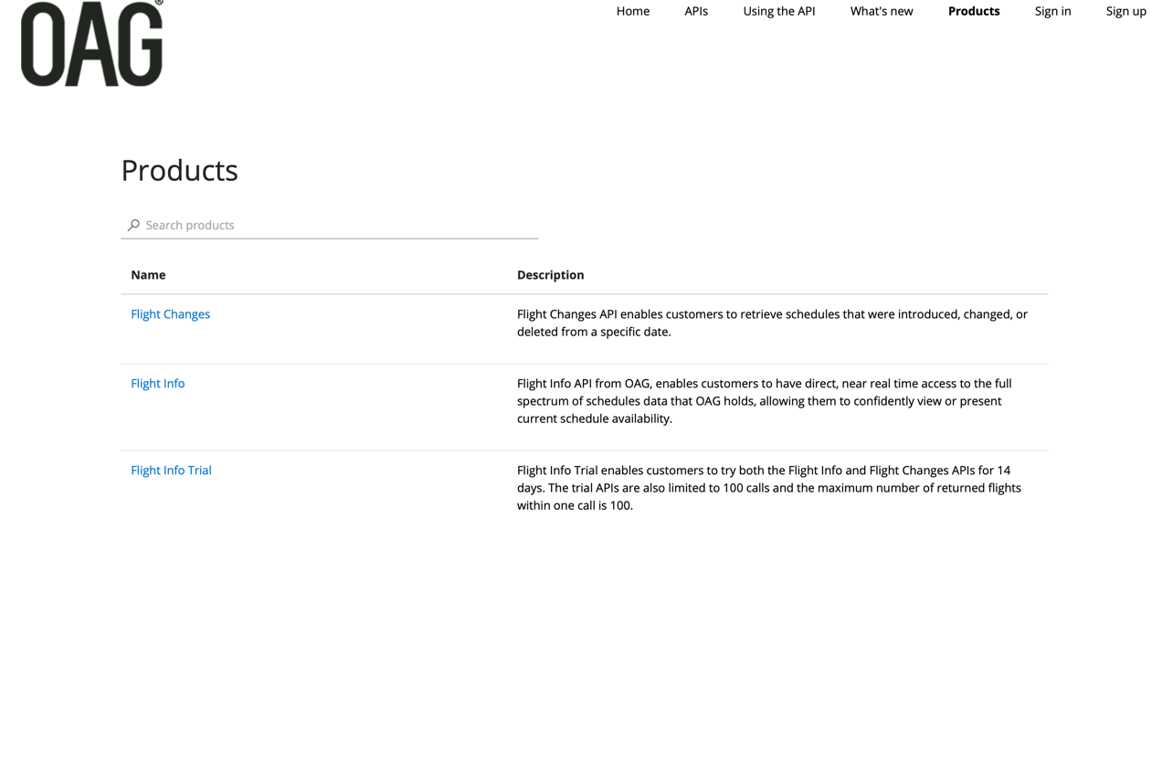
Subscribe to Flight Info Alert Product
Step two Select “Flight Info Alerts” on the product page.
Products
Flight Info Alerts (Preview)
Flight Info Alerts enables customers to access near real-time change events in the full spectrum of schedules data that OAG holds without needing an API lookup

Slide 6
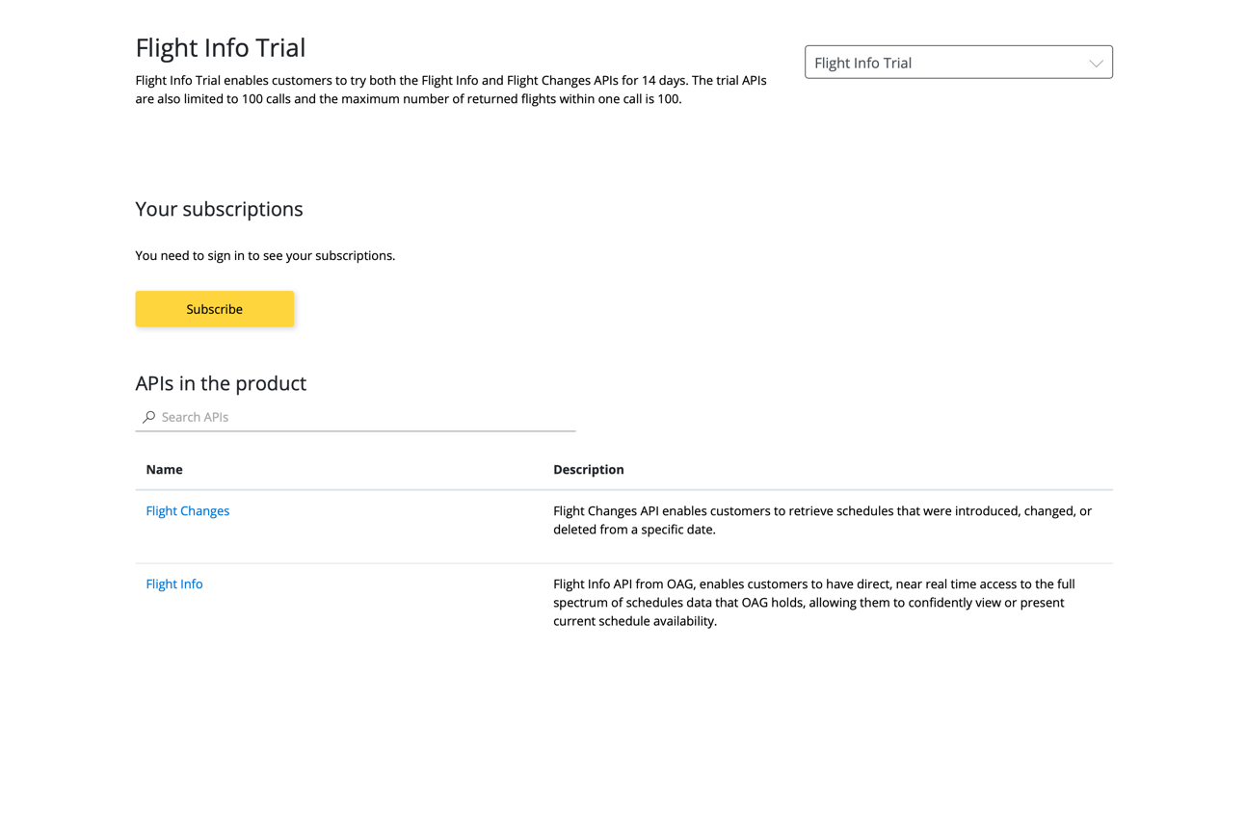
Subscribe to Flight Info Alert Product
Step three Click the “Subscribe” button to subscribe to Flight Info Alert.
Flight Info Alerts (Preview)
Flight Info Alerts (Preview)
Flight Info Alerts enables customers to access near real-time change events in the full spectrum of schedules data that OAG holds without needing an API lookup
Flight Info Alerts
Flight Info Alerts enables customers to receive alerts on flight schedules changes in near real-time according to their configured parameters and preferred frequency.
Complete Flight Info Alert profile
Enables the customer to setup the Flight Info Alert profile to receive a customer ID and access key to collect the alerts.
Create Alert
Enables the customer to create or configure alerts by specifying alert parameters

Slide 7
Subscribe to Flight Info Alert Product
Step four Enter your company name to subscribe and select the subscribe button.
Flight Info Alerts (Preview)
Flight Info Alerts (Preview)
Flight Info Alerts enables customers to access near real-time change events in the full spectrum of schedules data that OAG holds without needing an API lookup
Flight Info Alerts (Preview)
Flight Info Alerts
Flight Info Alerts enables customers to receive alerts on flight schedules changes in near real-time according to their configured parameters and preferred frequency.
Flight Info Alerts (Preview)
Flight Info Alerts enables customers to access near real-time change events in the full spectrum of schedules data that OAG holds without needing an API lookup

Slide 8
Subscribe to Flight Info Alert product
Step five You will be redirected to the profile page, where you will see your subscription keys. Subscription keys are deactivated, pending approval. Also, you will receive an acknowledgement email confirming your subscription and a welcome email upon the activation of the subscription keys.
User profile
Account details
Email name.name@company.com
First name name
Last name name
Registration date 01/05/2021
Change name
Change password
Close account
Subscriptions
Subscription details
Product
State
Action
Name
Requested on
01/05/2021 Primary key
Secondary key
Flight Info Direct (Preview)
d1aca97b2a404e23abc547f3oag36017
d1aca97b2a404e23abc547f3oag36017
Rename
Flight Info Alerts (Preview)
Cancel
Submitted
Hide | Regenerate Hide | Regenerate

Slide 9
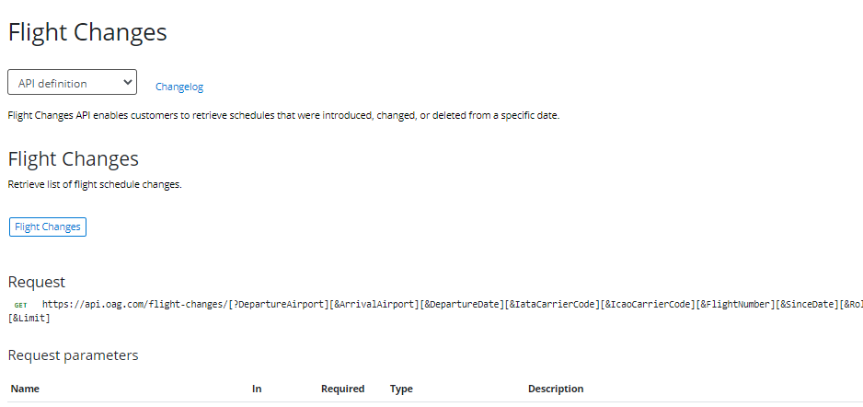
Profile Completion
Step six When the subscription is confirmed, you will need to complete your profile by navigating to Products > Flight Info Alert (preview) > Complete Profile
Flight Info Alerts (Preview)
Flight Info Alerts enables customers to access near real-time change events in the full spectrum of schedules data that OAG holds without needing an API lookup
Complete Profile
Creates the customer profile along with the dedicated eventhub, by the provided subscription ID, subscription key and mandatory parameters. Returns the customer account ID and security access key
Try it >
Profile
Request
POST https://flightinfoalerts-apim-di.azure.net/flight-info-alerts/profile
Request headers
Name
Required
Type
Description
Subscription key
true
string
Request body
Name
Required
Type
Description
accountid
false
string
Alphanumeric characters generated on the creation of the customer account ID

Slide 10
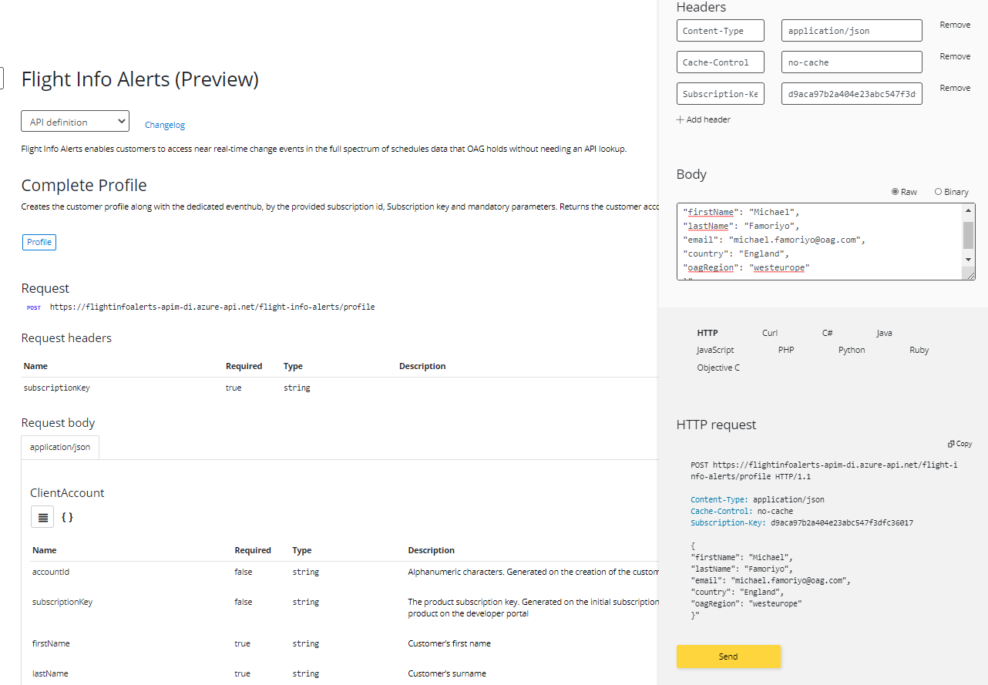
Profile Completion
Step seven You can complete your profile by entering the below into the “body” field.
Headers
Content -Type
application/json
Remove
Flight Info Alerts (Preview)
Content -Control
No-cache
Remove
Subscription-Key
d9aca79b2a404e23acg547f3t
Remove
+ Add header
Body
{
"firstName": “FirstName",
"lastName": “LastName",
"email": “EmailAddress",
“secondaryEmail”: “Secondary EmailAddress”
"country": “ISO Country Code e.g FR",
}
Flight Info Alerts enables customers to access near real-time change events in the full spectrum of schedules data that OAG holds without needing an API lookup
Raw Binary
Complete Profile
”firstName”: ”Name”’
“lastName”: “Name”,
“email”: “name.name@company.com”, ”country”: “England”, “oagRegion”: “westeurope”
Creates the customer profile along with the dedicated eventhub, by the provided subscription ID, subscription key and mandatory parameters. Returns the customer account ID and security access key
Profile
HTTP Curl C‹ Java
JaveScript PHP Python Ruby
Objective C
Request
HTTP request
POST https://flightinfoalerts-apim-di.azure.net/flight-info-alerts/profile
Copy
Request headers
POST https://flightinfoalerts-apim-di.azure-api.net/flight- info-alerts/profle HTTP/1.1 Content-Type: application/json Cache-Control: no-cache
Subscription-Key: d9aca79b2a404e23acg547f3t
{ ”firstName”: ”Name”’
“lastName”: “Name”,
“email”: “name.name@company.com”, ”country”: “England”, “oagRegion”: “westeurope”
}”
Name
Required
Type
Description
Subscription key
true
string
Request body
Name
Required
Type
Description
accountid
false
string
Send
Alphanumeric characters generated on the creation of the customer account ID

Slide 11
Profile Completion
Step eight
Send
Flight Info Alerts (Preview)
HTTP response
HTTP/1.1 201 Created content-type: application/json date: Wed, 14 Apr 2021 15:24:22 GMT
Vary: Origin
x-powered-by: ASP.NET
{ “accountId”: “010b637a-481e-454a-8011-f82af374f1b6”,
”evtPrimaryConnectionString”: “Endpoint=sb://nsclienteuc9
a36628d.servicebus.windows.net/;SharedAccessKeyName=listenrule;SharedAccessKey=SSGt3jgpHLyt0D2fWj+ec2w8/jqnxxryW8oMqpgg+o=;EntityPath=eh43b6935562”,
“evtSecondaryConnectionString”: “Endpoint=sb://nsclienteuc 9a36628d.servicebus.windows.net/;SharedAccessKeyName=listenrule;SharedAccessKey=rXoX0/9Gasefpgzo4jtFH1ouuAeJM9CC7RwD+22o6nc=;EntityPath=eh43b6935562” }
Flight Info Alerts enables customers to access near real-time change events in the full spectrum of schedules data that OAG holds without needing an API lookup
You’ll need your account id to create, update, delete and retrieve your alerts.
Complete Profile
Creates the customer profile along with the dedicated eventhub, by the provided subscription ID, subscription key and mandatory parameters. Returns the customer account ID and security access key
Profile
Request
Primary and secondary access keys to connect to your dedicated eventhub.
POST https://flightinfoalerts-apim-di.azure.net/flight-info-alerts/profile
Request headers
Name
Required
Type
Description
Subscription key
true
string
Request body
Name
Required
Type
Description
accountid
false
string
Alphanumeric characters generated on the creation of the customer account ID

Slide 12

Create Alerts

Slide 13


Alert Configuration Types
Global Alert
Alerts will be received on all schedule changes. No additional parameter is required
Note: The global alert configuration encompasses all other alert types. As such separate non-global alerts will not be received for carriers or port alert configurations. To receive non-global alerts, the global alert must be set to inactive by setting the active field to false with the “Update Alert” method
Non-global alert
Carrier Alert : Filters schedule changes by the provided carrier code. Further filtering of carrier-related changes can be set with any combination of the following parameters;
Flight number – Alerts will be received for the carrier code and flight number provided code and flight number provided
Flight number range – Alerts will be received for the carrier code and flight number range provided
Departure airport – Alerts will be received for the carrier code and departure airport code provided
Arrival airport – Alert will be received for the carrier code and arrival airport provided arrival airport code provided
Note: When a flight alert is created, no checks are performed to determine if the alert represents an actual flight. As such, no alert will be received unless it matches a schedule change event.

Slide 14
Alert Validations
M = mandatory O = optional
Alert type | Name of Alert | Carrier Code | Flight number | From flight | To flight | Departure Airport | Arrival Port | Comment
Carrier | O | M | O | O | O | O | O | If IATA, then the code must be 2 characters If ICAO, then the code must be 3 characters
Flight | O | M | M | O | O | O | O | For flight range at least one flight number must be provided
Port | O | O | O | O | O | M | O | At least one port must be provided

Slide 15

Connecting to the Eventhub

Slide 16
Language/Platform Support for Azure Event Hubs/OAG Alerts
Language | Azure | App | AWS | App | Google | App | On Prem | App
 | Function | App | Lambda | App | Function | App | Function | App
.Net (C#) | ✓ | ✓ | ? | ✓ | ? | ✓ | n/a | ✓
Java | ✓ | ✓ | ? | ✓ | ? | ✓ | n/a | ✓
Python | ✓ | ✓ | ? | ✓ | ? | ✓ | n/a | ✓
JavaScript | ✓ | ✓ | ? | ✓ | ? | ✓ | n/a | ✓
Go | ✓ | ✓ | ? | ✓ | ? | ✓ | n/a | ✓
C/C++ | ✓ | ✓ | ? | ✓ | ? | ✓ | n/a | ✓
Azure Cli | ✗ | ✓ | ✗ | n/a | ✗ | n/a | n/a | ✓
Azure Powershell | ✗ | ✓ | ✗ | n/a | ✗ | n/a | n/a | ✓
Apache Kafka | ✓ | ✓ | ✓ | ✓ | ? | ✓ | n/a | ✓
Function: Cloud provided serverless function
App: Language created component that runs within an app service, container, VM or physical server, connecting to a hub via an SDK
Code samples from OAG or visit
https://docs.microsoft.com/en-us/azure/event-hubs/event-hubs-samples

Slide 17
Other Helpful Resources
Microsoft Azure Event Hubs developer documentation
https://docs.microsoft.com/en-us/azure/event-hubs/
Understanding the consumer side of Azure Event Hubs
https://www.serverless360.com/blog/understanding-consumer-side-of-azure-event-hubs-checkpoint-initialoffset-eventprocessorhost
https://devblogs.microsoft.com/azure-sdk/eventhubs-clients/
Java specific examples (includes EventPosition) – available in all supported languages
https://github.com/Azure/azure-event-hubs/tree/master/samples/Java/Basic
To access events from a position in time, offset or sequence number - available in all supported languages
https://docs.microsoft.com/en-us/dotnet/api/microsoft.azure.eventhubs.eventposition?view=azure-dotnet
https://www.codota.com/code/java/classes/com.microsoft.azure.eventhubs.EventPosition
Checkpointing
https://docs.microsoft.com/en-us/java/api/overview/azure/messaging-eventhubs-checkpointstore-blob-readme?view=azure-java-stable
A custom checkpoint store can be created by overriding the Checkpointstore class.
Using AWS Lambda with self-managed Apache Kafka – use this to connect through to Azure Event Hub
https://docs.aws.amazon.com/lambda/latest/dg/kafka-smaa.html
OAG has a set of sample code addressing certain use cases.

Slide 18
THANK YOU!

